Slide 1
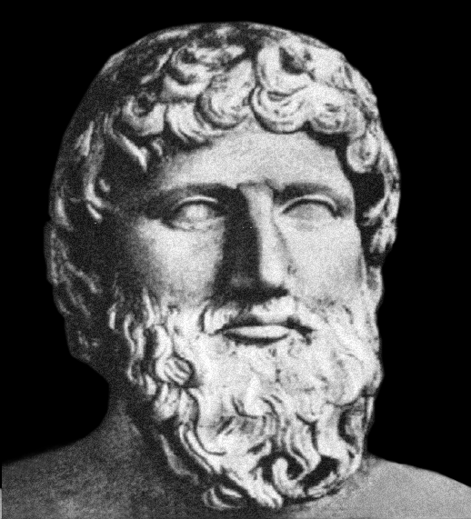
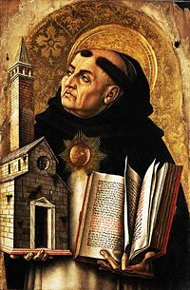
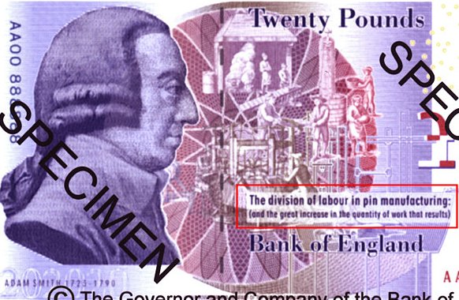
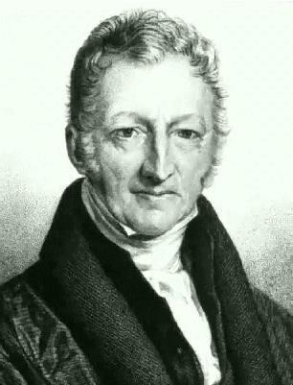
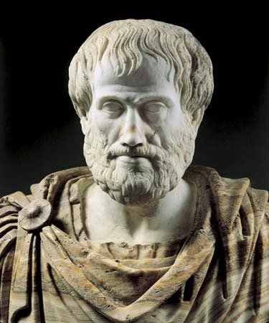
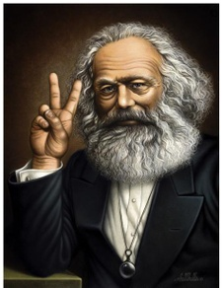
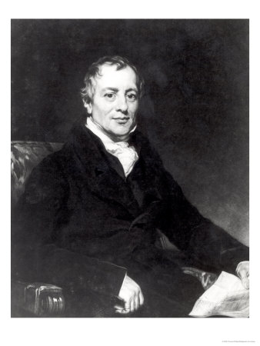
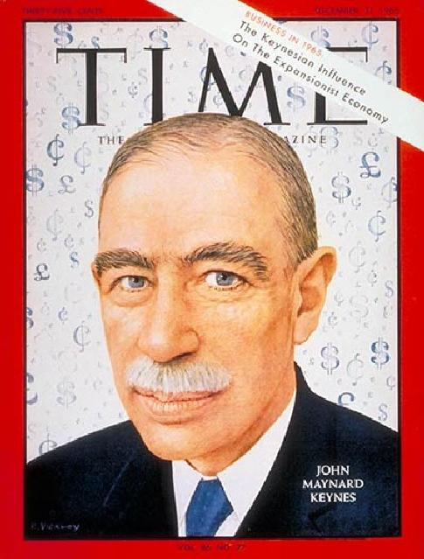
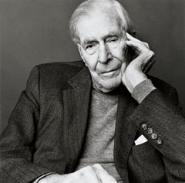
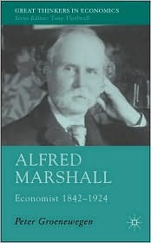
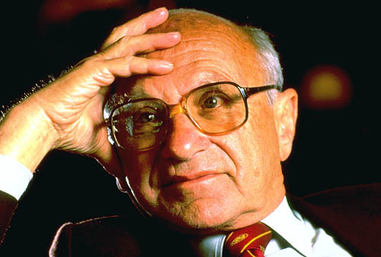
The History of Economic Thought

Slide 2
LC Economics Syllabus
Economic System and Economic Thought
Brief historical outline of economic thought – Smith, Marx, Keynes etc.
Market, centrally planned and mixed economies.

Slide 3
Exam Questions OL
Short
Long
2007 Q 9 Match
2006 Q 4 Match
2004 Q 8 Cannons of Tax
2003 Q 7 Match
2001 Q 4 Match
2000 Q 9 Smith
2010 Q 4 (b) Keynes - Mult
2010 Q 5 (b) Smith - COT
2008 Q 5 (c) Smith COT
2005 Q 5 (c) Smith COT, DOL
Powerpoint produced by Rachel Farrell (PDST) & Aoife Healion (SHS, Tullamore)
Sources of information: SEC Marking Schemes, newspaper articles & documentaries

Slide 4
Exam Questions HL
Short
Long
2005 Q 8 Keynes
2002 Q 4 Keynes
2001 Q 8 Monetarists
2000 Q 9 Smith
2010 Q 6 (b) Milton Friedman
2009 Q 7(c) Ricardo
2007 Q 4 (c) Smith/Marshall/Keynes/Freidman
2003 Q 8 (c) Smith
Powerpoint produced by Rachel Farrell (PDST) & Aoife Healion (SHS, Tullamore)
Sources of information: SEC Marking Schemes, newspaper articles & documentaries

Slide 5
Watch out for the following definitions contained in this presentation!!
Fiscal Policy
Monetary Policy
Consumer Surplus
Price Elasticity of Demand (PED)
Cannons of Taxation
Quasi Rent
Protectionism
Laissez-faire
Iron Law of Wages
Law of Diminishing Marginal Returns
Economic Rent
Law of Comparative Advantage
Say’s Law
The Multiplier
Liquidity Preference Theory

Slide 6
Early Economists
Plato (427-347 BC)
Aristotle (384-422 BC)
Thomas Aquinas (1225-1274)
Not on the course but worth a look for interest sake!

Slide 7
Plato (427-347 BC)
Division of labour
Currency system
Individual subordinate
to the state
Public administration & finance

Slide 8
Aristotle (384-322 BC)
True/genuine wealth
limited
Eg. agriculture, mining
Unnatural wealth
unlimited
eg. exchanging
Money
Measure of wealth
Store of value
Value in use
Value in exchange

Slide 9
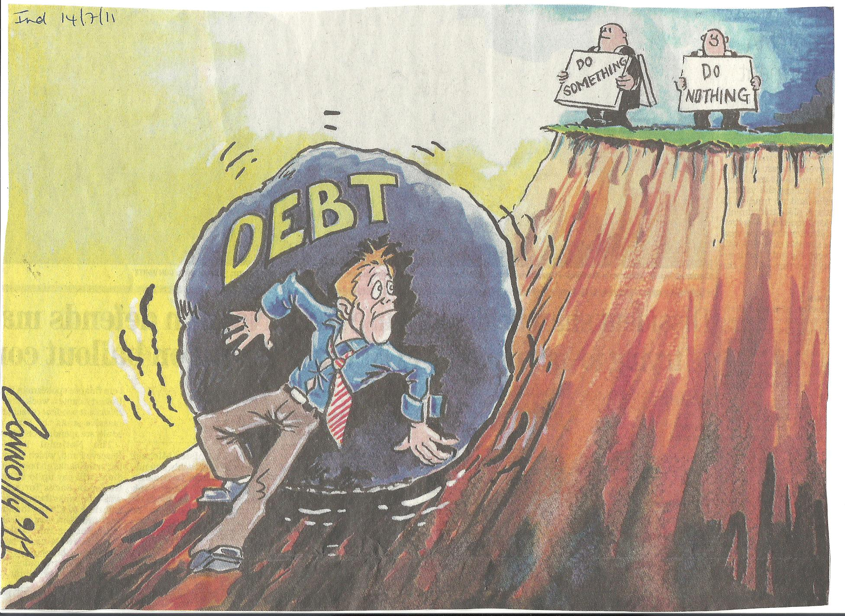
Sisyphus!!!!

Slide 10
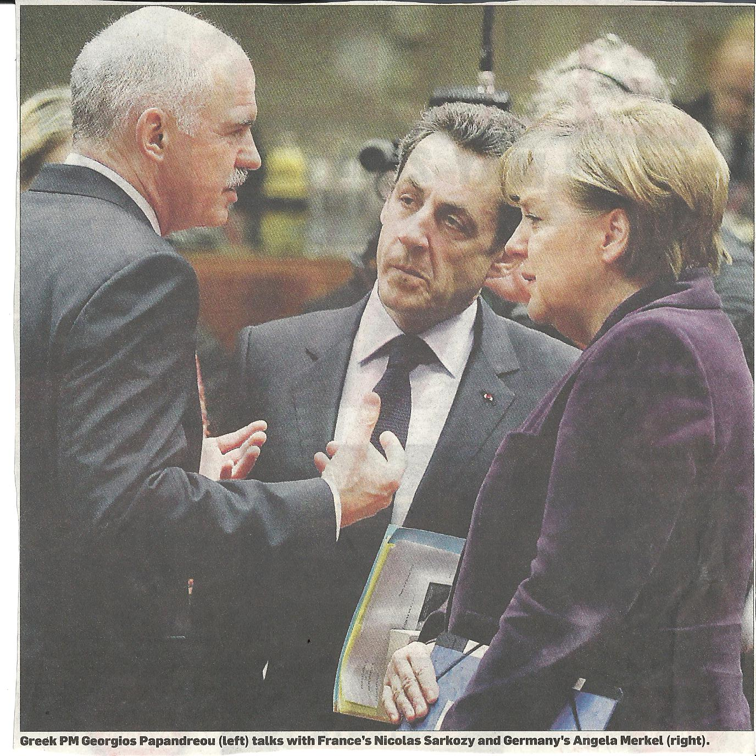

Slide 11
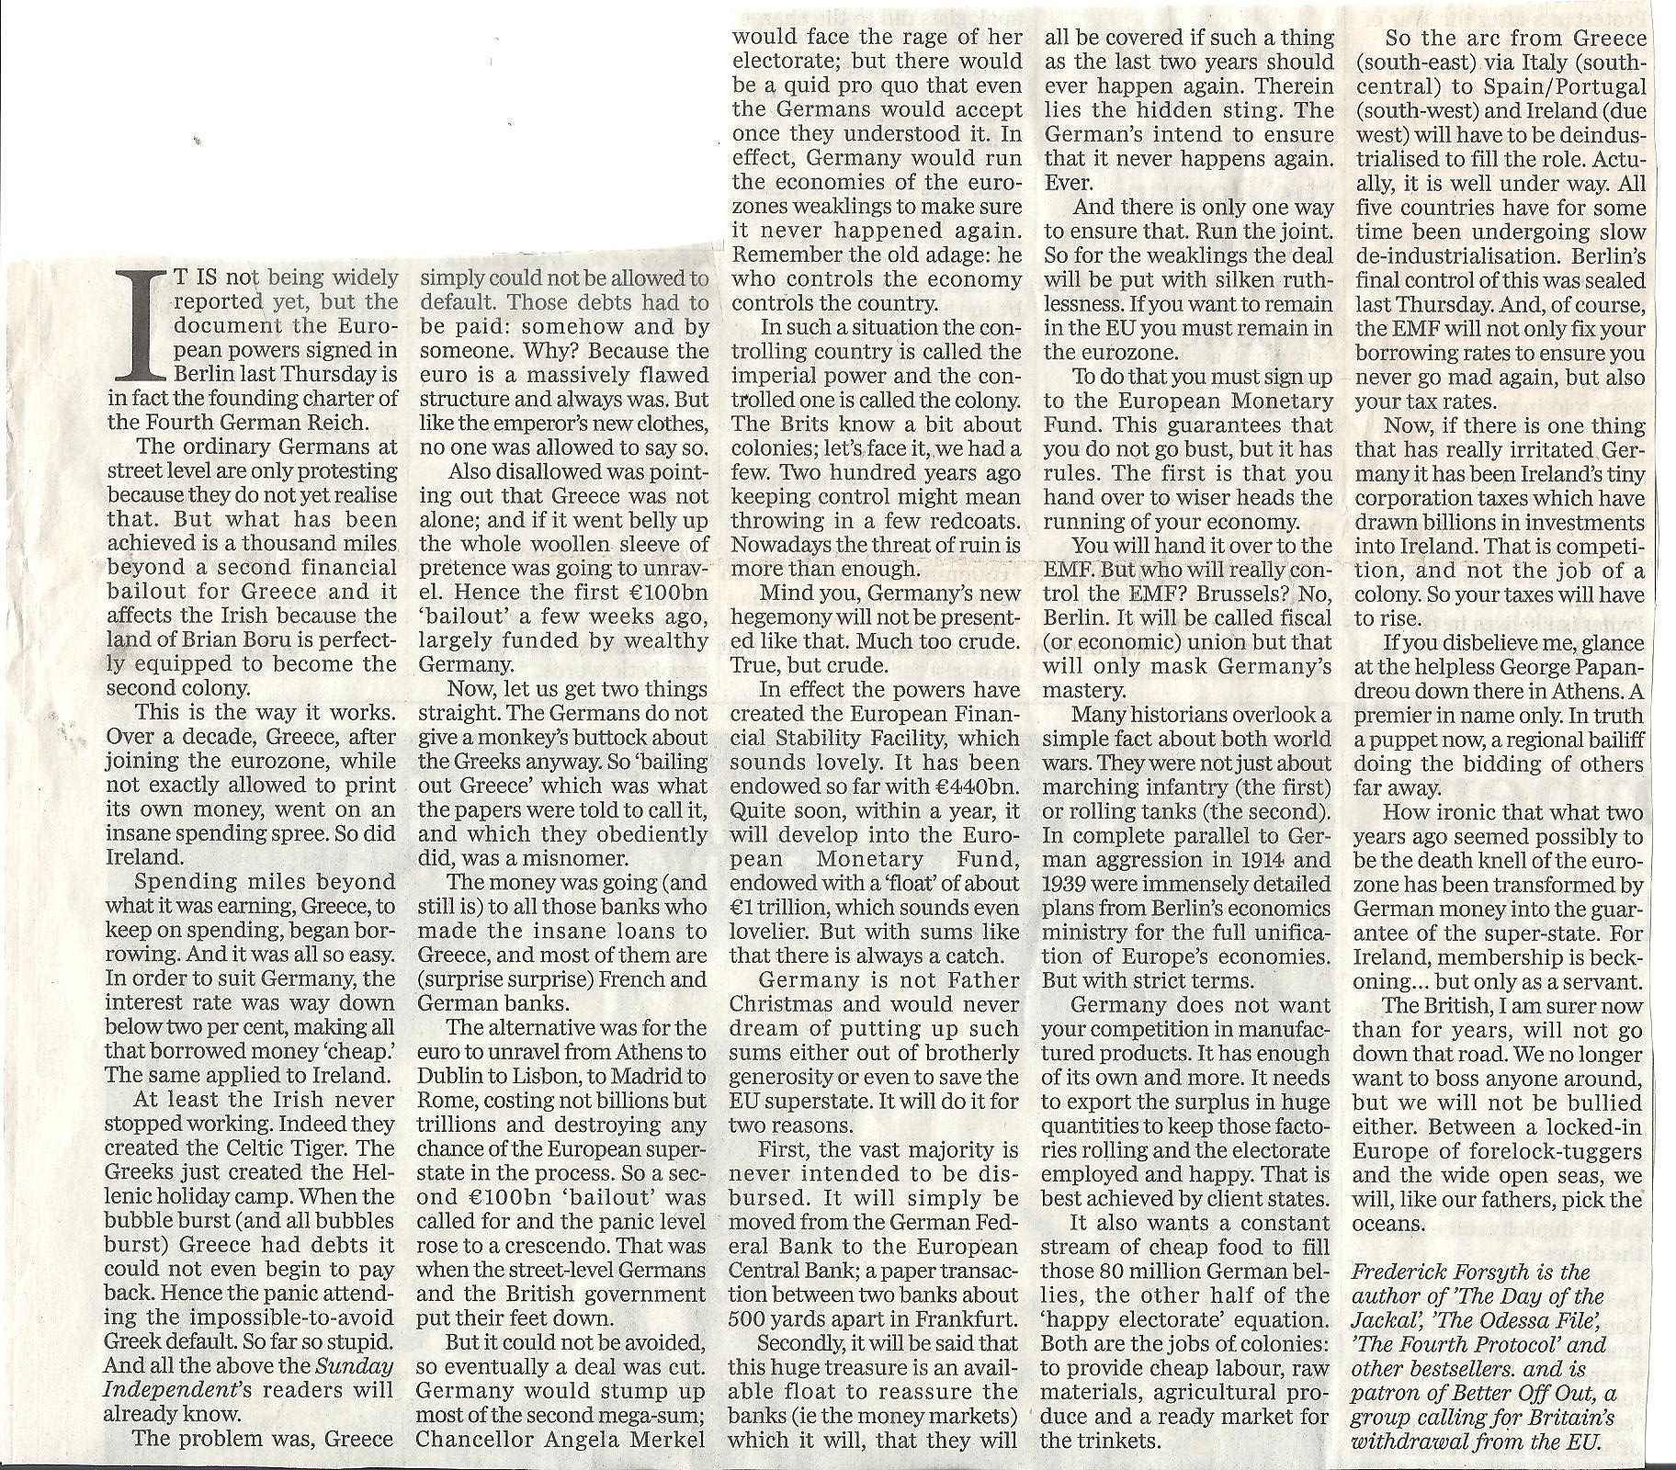
How the Greeks got into
so much trouble!
Independent July 2011

Slide 13
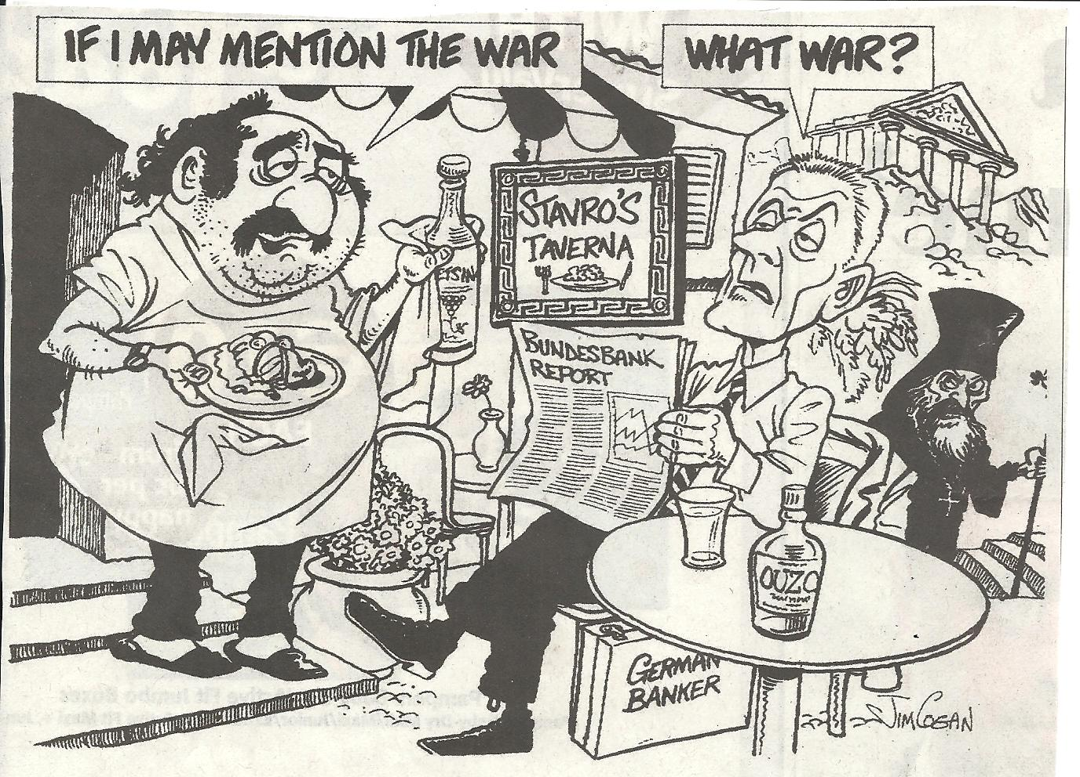

Slide 14
Thomas Aquinas (1225-1274)
Common ground
Christian principals co-exist with
economic life
Morality of wealth depended on its use
Concerned about money lending & unjust price charged for it

Slide 15
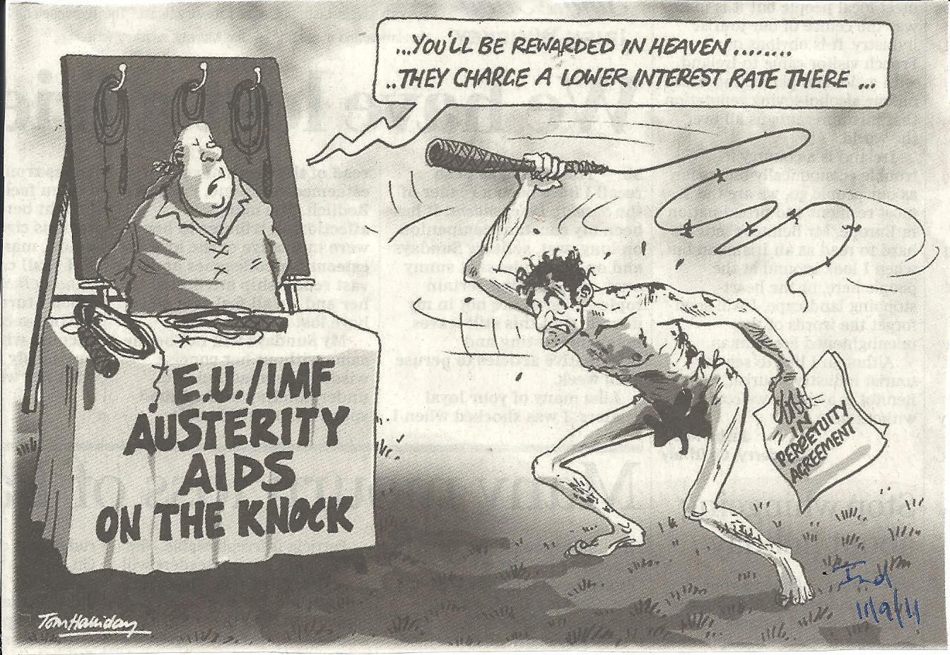

Slide 16
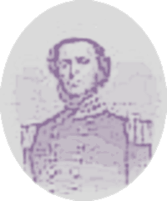
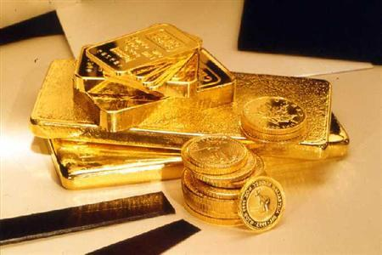
The Mercantilist (1500-1780)
Thomas Mun (1571-1641)
Believed that;
Gold was the prime measure of a countries wealth.
Exploitation of colonies.
Protectionism.

Slide 17
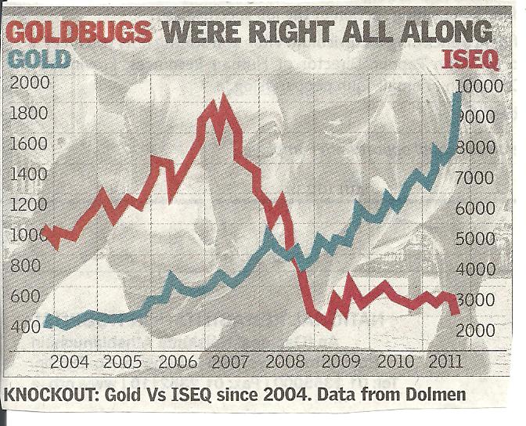

Slide 18
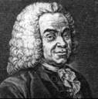
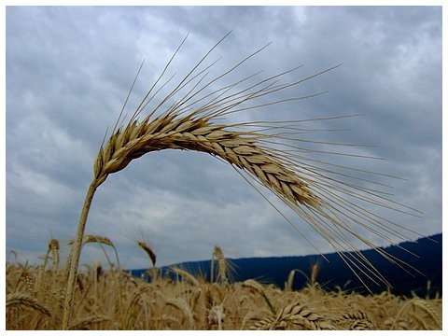
The Physiocrat (1750-1800)
Francois Quesnay (1694-1774)
Wrote “Economic Table”.
Believed that;
Wealth had its origin in agriculture.
Private ownership of property important.
Non gov intervention (except for laws).
Free trade.

Slide 19
The Classical Economists
Adam Smith (1723-1790)
Thomas Robert Malthus (1766-1834)
David Ricardo (1772-1823)
Jean Baptiste Say (1767-1832)
John Stuart Mill (1806-1873)

Slide 20
Adam Smith
Classical Economist
Scottish
(1723 – 1790)
“……The Wealth of Nations”
Pursuit of self interest
Benefited individual therefore society
Laissez-faire
No justification for government intervention except for defence/justice
Division of Labour
Increases productivity and a country’s wealth.
Eg. it takes 18 different operations to make a pin!
Invisible hand of competition
Allows self regulation to operate ensuring economic progress
Labour theory of
value & wealth
The value of an item is equal to the amount of labour that goes into producing it
Free Trade
With no tariffs/tax, markets operate effectively & trade to be spread between nations
Cannons of Taxation
Fair tax system; equity
economy
certainty
convenience

Slide 21
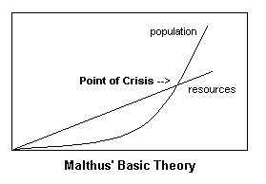
Thomas Robert Malthus
Classical Economist
English
(1776-1834)
“The Principles of Population”
Applied the Law of Diminishing Returns to Land
Best land taken up first, then next best, then inferior….
At each stage the amount of food is less than before.
Theory of
Population & Food
Population grows geometrically (2,4,8,16,32).
Food grows arithmetically (1,2,3,4,5,6).
If population not kept in check famine & disease would result.
SOL did not fall in 19th C but his ideas were more relevant in the population explosion of the 20th C
Iron Law of Wages
An increase in wage above subsistence level
= increase in population
= increase in supply of labour
=decrease in wage

Slide 22
Economic Rent
If population increases inferior land used.
For use of land rent was paid.
Cost of producing on the best land was lower.
Food produced on good land earned a surplus over that produced on inferior land.
This surplus led to an increased rent payable for the use of good land.
David Ricardo
Classical Economist
English
(1772-1823)
“The Principles of Political Economy & Tax”
Law of
Comparative
Costs/Advantage
Supported idea of free trade.
A country should specialise in the production of those goods in which it is relatively most efficient .
And trade for the remainder of it’s reqiuirements.
Accepted the Subsistence Wage Theory
He agreed that an
increase in wage above subsistence level
= increase in population
=decrease in wage

Slide 23
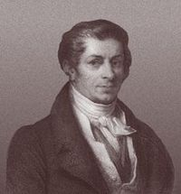
Jean Baptiste Say (1767-1832) Wrote: “Treatise on Political Economy”
Says law
“Supply creates it’s own demand”.
People make products they are most efficient at.
They exchange their surplus for money.
They use this to buy goods that they want.
Therefore the supply of goods creates a demand for goods.

Slide 24
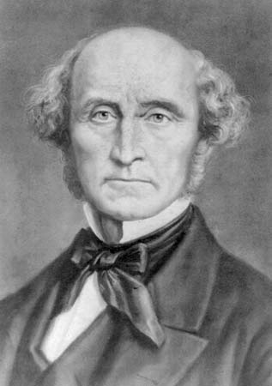
John Stuart Mill (1806-1873) Wrote: “Principals of Political Economy…”
He advocated the following;
Demand & supply were important in assessing the value of a product.
Law of diminishing marginal returns.
Predicted the emergence of dominant firms.
Establishment of trade unions to counteract the power of dominant firms.
Mill became disillusioned by the capitalist system & began to lean towards a mild form of socialism.

Slide 25
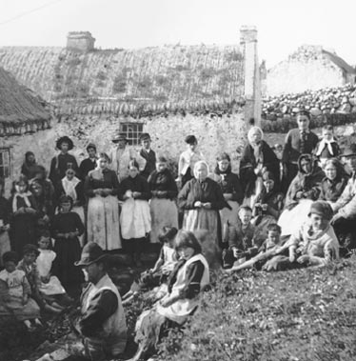
“Nothing can be done for Ireland without transforming the rural population from cottier tenants into ….land proprietors (owners)”.
JS Mill, “Principles of Political Economy” (1848)

Slide 26
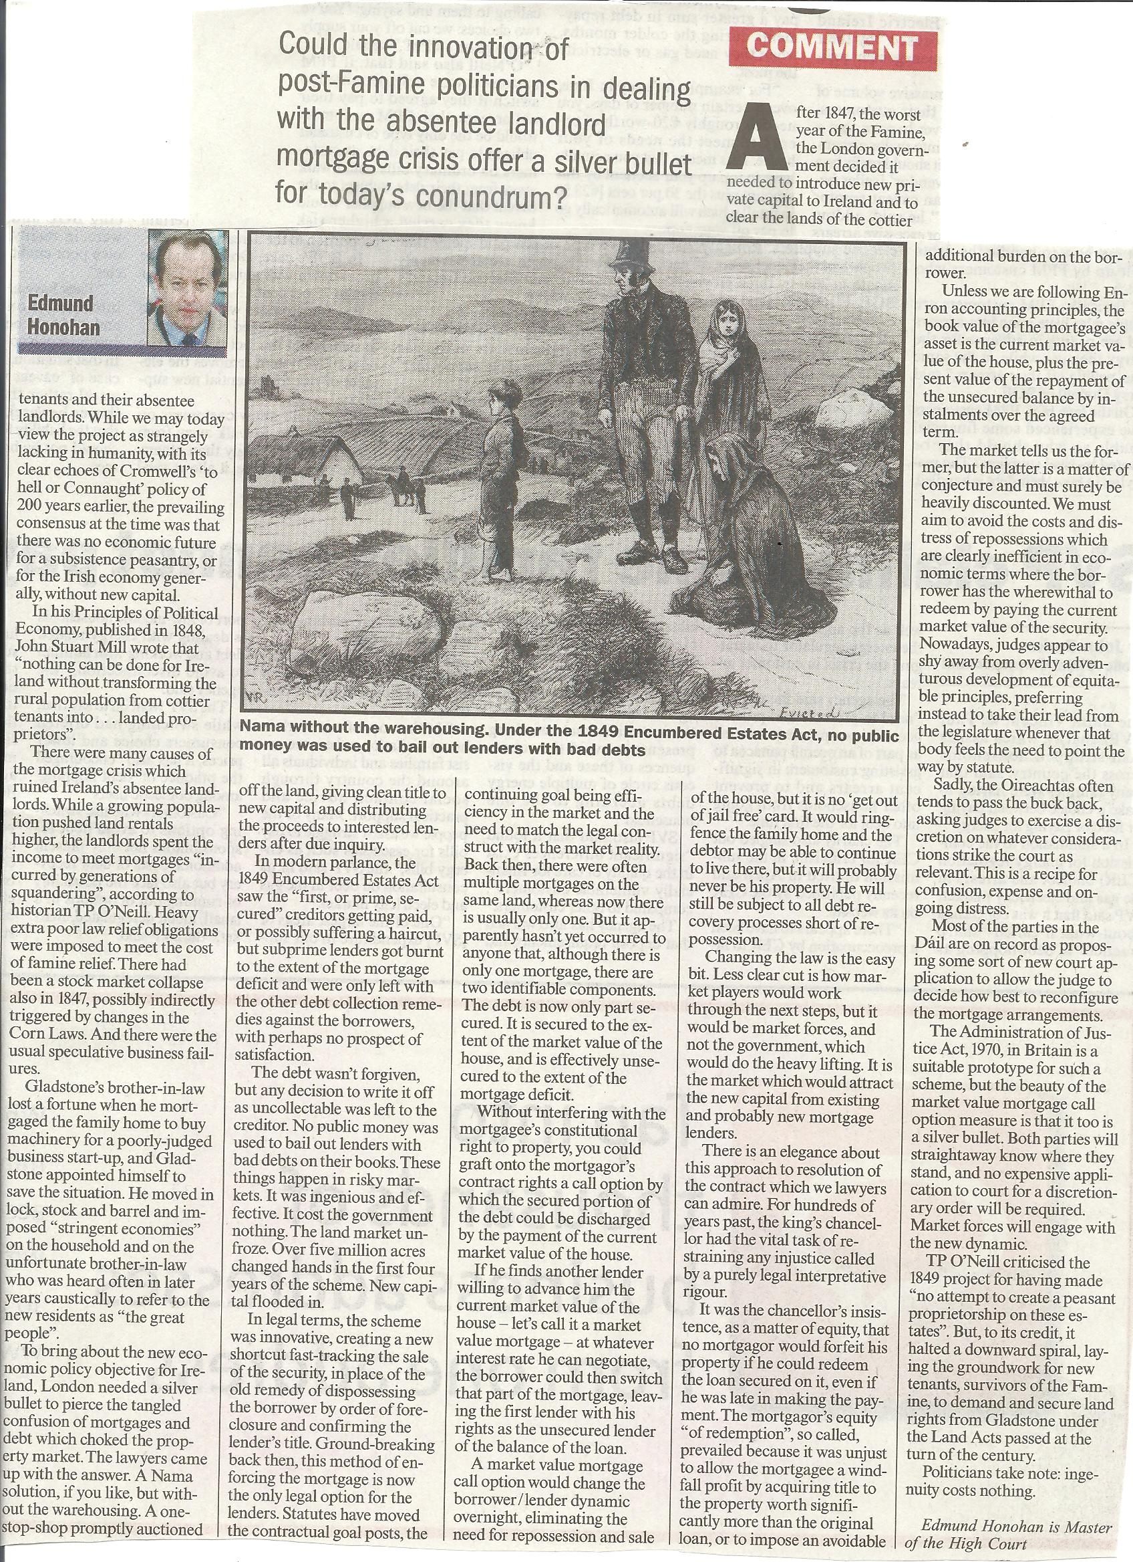
“Lessons in ingenuity from the Victorian age.”

Slide 27
The Socialists
Karl Marx (1818-1883)

Slide 28
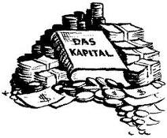
Karl Marx
Socialist
German
(1818-1883)
“The Communist Manifesto”
Written by
K. Marx
Predicted
Growth of oligopolies
Forecasted
Emergence of trade cycles
Labour theory
People required to work more hours than necessary to generate the income needed to pat their wages.
Social revolution
Where proletariat would take public ownership of the FOP
Two tiered society
=unequal distribution of wealth
Capitalists (owners)
Proletariat (workers)
Profit
Labour produced a surplus value which was profit for employers
Profits invested in technology
Reduced need for labour = unemployment

Slide 29
Criticism of
Karl Marx
The growth of unions ensured protection of working class.
Middle & professional classes emerged.
Technology did not lead to mass unemployment.
However
Predictions on oligopolies & trade cycles came true.

Slide 30
The Neo-classical Economists
Alfred Marshall (1842-1924)

Slide 31
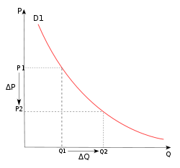
Alfred Marshall
Neo-classical
English
(1842-1924)
“The Principles of Economics & Money, Credit & Commerce”.
Theory of Value
The value of an item is determined;
SR by utility and demand
LR by cost of production
Quasi Rent
Economic rent earned by FOP in SR when D>S
Consumer Surplus
The difference between what a consumer actually pays for a good and the maximum which he/she would have been willing to pay rather than going without it.
Growth of monopolies could be prevented by;
Gov regulation
Consumer information
More accountability
Distribution of income/wealth
The return to each FOP is determined by their marginal utility
Price-elasticity of demand
Quantified buyers’ sensitivity to price changes

Slide 32
Marshall’s scissors analogy.
Demand & supply are interdependent just like the blades of a scissors.

Slide 33
Keynesian Economists
John Maynard Keynes (1883-1946)

Slide 34
Favored government intervention
It is the job of the gov to run the economy
Gov can use fiscal policy (any action taken by the gov which alters current revenue & exp) to create full employment
John Maynard Keynes
Keynesian
British
(1883-1946)
“The General Theory of Employment, Interest & Money”
Liquidity preference theory
3 reasons (motives) for holding money
Transaction motive
Precautionary
Speculative
(See chap on capital)
If Inv<Saving=Leakage
Leads to a decrease in national income & employment
Investment decisions
Depends on expectations not rate of interest
The multiplier
Shows the relationship between an initial injection into the circular flow of income and the eventual total increase in national income.

Slide 35
The Monetarists
Milton Friedman (1912-2009)

Slide 36
Monetary policy
Should be the main instrument used by the government to manage the economy.
(Actions taken by the gov/ECB which influences the money supply, interest rates and availability of credit).
Milton Friedman
Monetarist
(1912 -2009)
“A Monetary History of the US”
Laissez faire
Minimum state intervention
De-regulation of markets
Privatisation
Supply side policies
Improve market efficiency, boost supply, reduce the power of trade unions.
Reduction in inflation
Leads to increases competitiveness,
cheaper exports & job creation in the long run.
Co’s keep wage increases to a minimum to avoid cost-push inflation.
Control of money supply
Control inflation by strict control of money supply.
Restrict loans & high interest rates.

Slide 37
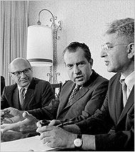
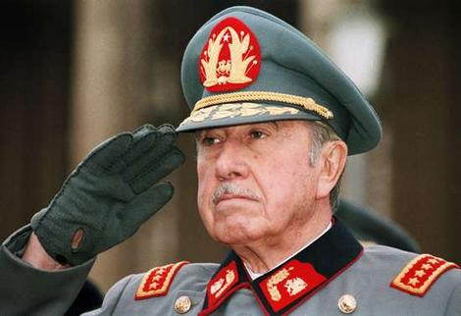
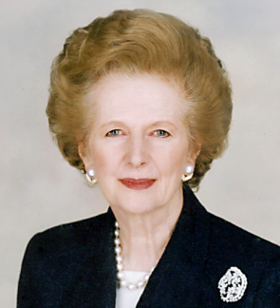
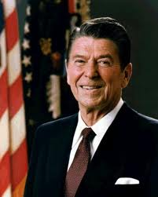
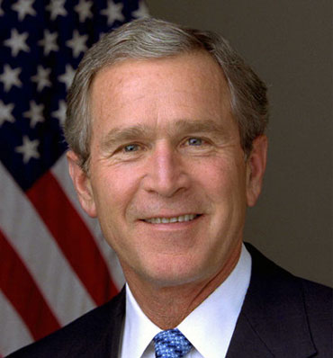
The Shock Doctrine
Advisor to Nixon, Pinochet, Thatcher, Regan & GW Bush Jnr

Slide 38
Are We Witnessing the Shock Doctrine in Effect?
Milton Friedman debates Naomi Klein

Slide 39
Other Modern Economists
Supply-siders
J. K. Galbraith (1908-2006)

Slide 40
Supply-sider theorists
Late 20th Century
Economy developed by stimulating the supply of goods.
Reduce taxes, encourage work, investment & government revenue.
Deregulation & privatisation encourages competition, increase word production & reduce prices.
Controversial because it advocates reduction of higher rates of tax which benefits the wealthy.
However supply siders claim that reducing tax rates will lead to increased tax revenue.
This is because increasing tax rates is a disincentive to work & invest.

Slide 41
J. K. Galbraith
Maverick
Keynesian/liberalist
(1908-2006)
Wrote the book
“The Affluent Society”.
Recommended that governments should increase tax to reduce conspicuous consumption.
Warned of economic power of multinational oligopolies.

Slide 42
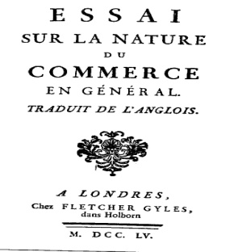
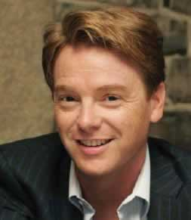
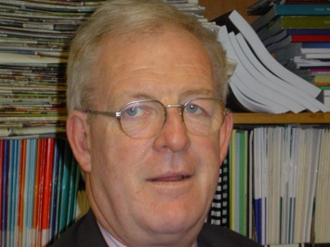
Some Irish Economists
Richard Cantillon (1680-1734)
David Mc Williams
Constantine Gurdiev
Susan Hayes
Morgan Kelly
Colm McCarthy
We adpoted him!

Slide 43
Suggested Resources
Print out this pp and cut into 6 pieces to use for “My Little Book” methodology.
Cloze tests
Crosswords
Matching exercises
Wordwall games
Exam questions templates

Slide 44
The Business 2,000 Economics Challenge online
The Scoilnet History of Economic Thought
Both have been copied here in case you do not have internet access or you may use these resources for tests.
Click below for on-line quiz

Slide 46
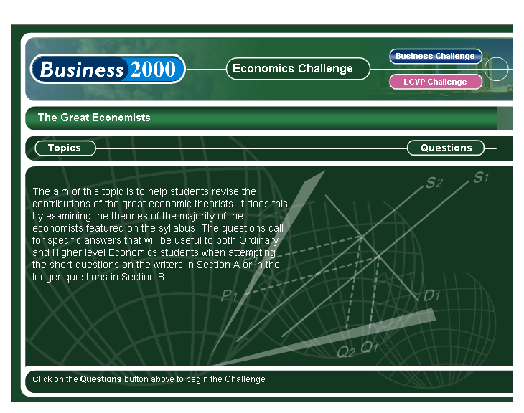

Slide 47
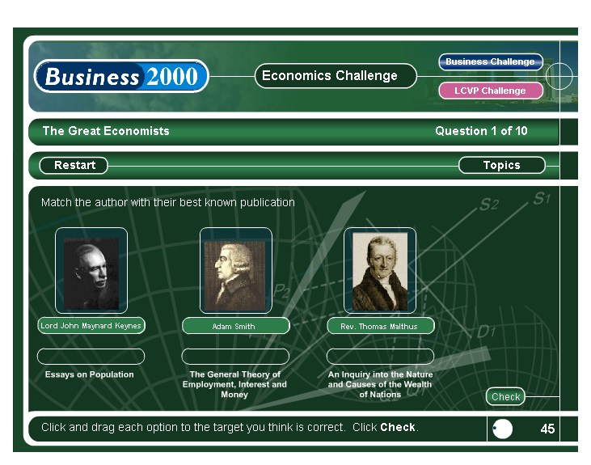

Slide 48
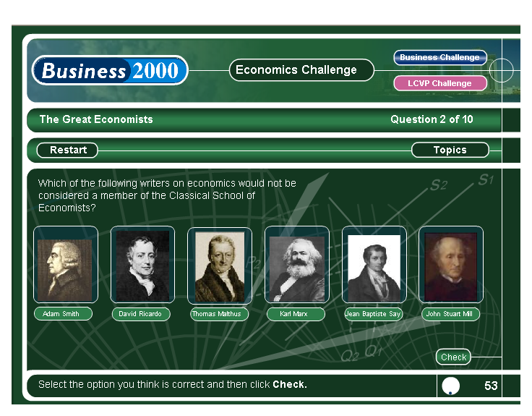

Slide 49
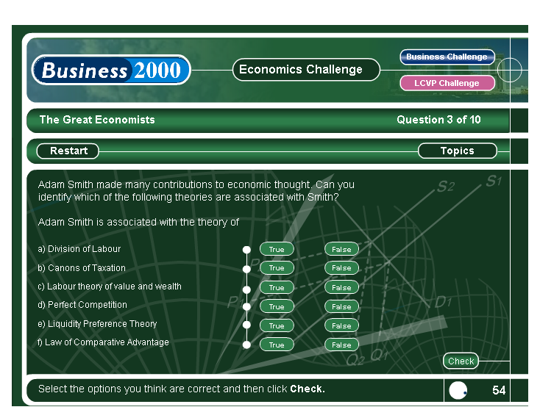

Slide 50
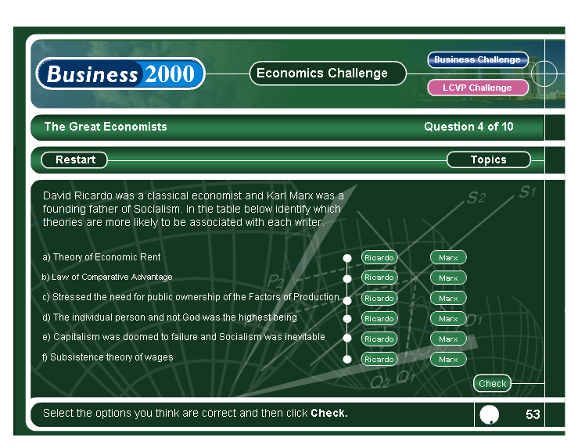

Slide 51
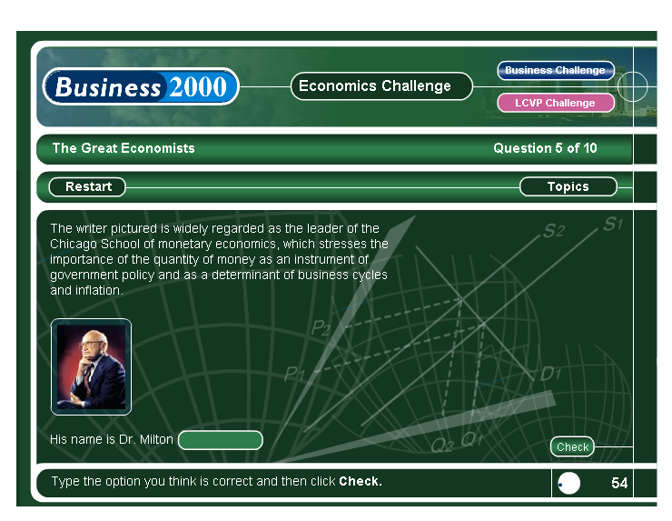

Slide 52
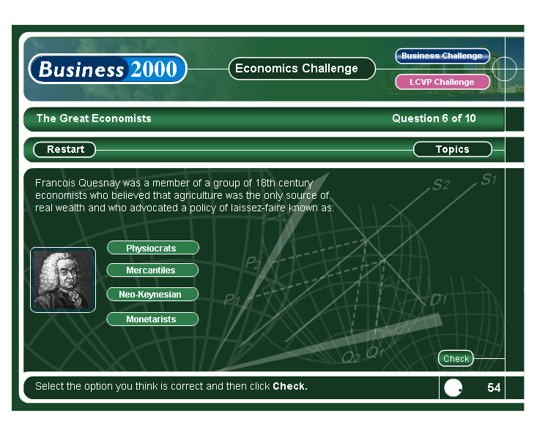

Slide 53
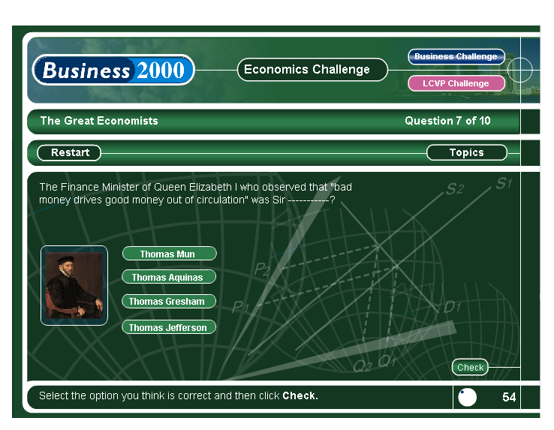
Gresham’s Law
“Bad money”
notes & coins
“Good money”
precious metals

Slide 54
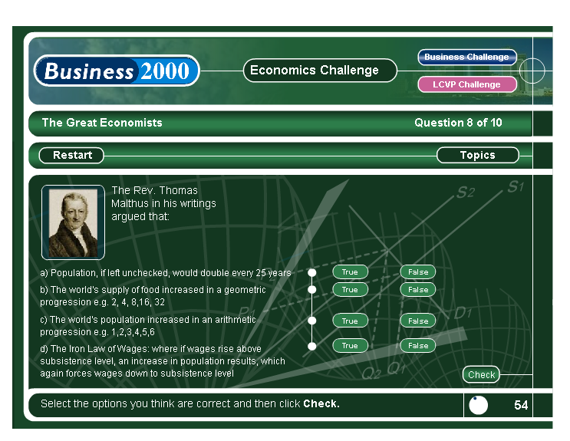

Slide 55
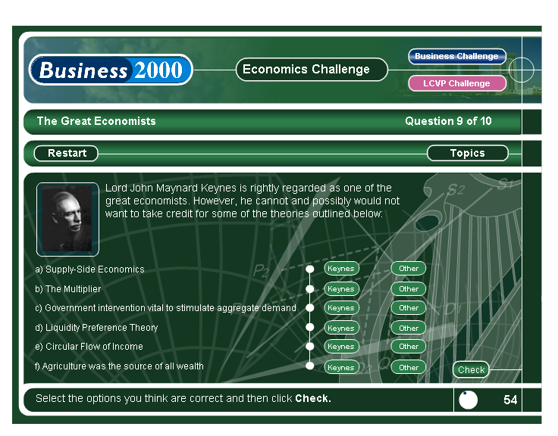

Slide 57
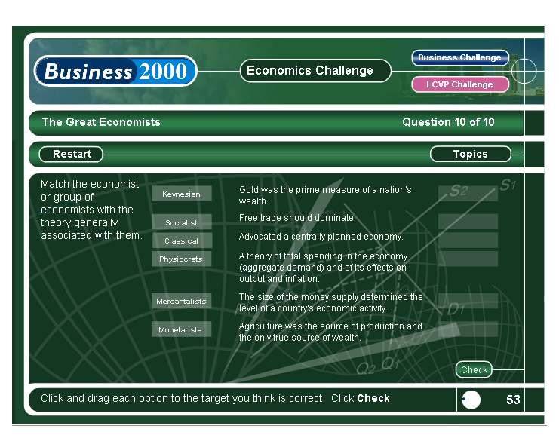

Slide 58
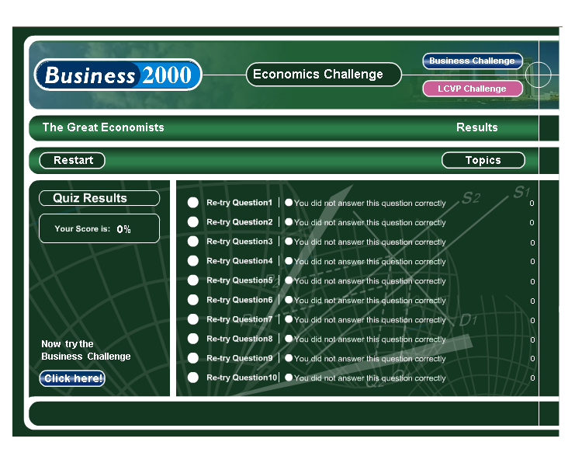

Slide 61
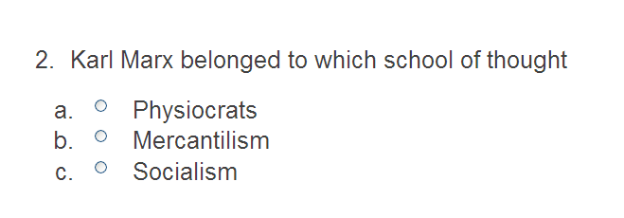

Slide 65
