Slide 1
Chapter 3: Human Elective
Migration

Slide 2
Terms you need to know…..
Migration: long-term movement of people from one region to another
Emigration: (e for exit) people leave an area
Immigration: (I for inward) people arrive in an area
Donor country: (source area) the country from which migrants leave
Host country: (destination area) the country that receives migrants
REMEMBER: A COUNTRY CAN BE A HOST AND A DONOR COUNTRY

Slide 3
Net migration: (migration balance) the difference between the number of immigrants and the number of emigrants in a country
Refugee: people who leave country because of fear of persecution based on religion, race/politics and who has been given refugee status in new country
Asylum seeker: people who apply for refugee status in a country to which they have moved

Slide 4
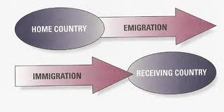

Slide 5
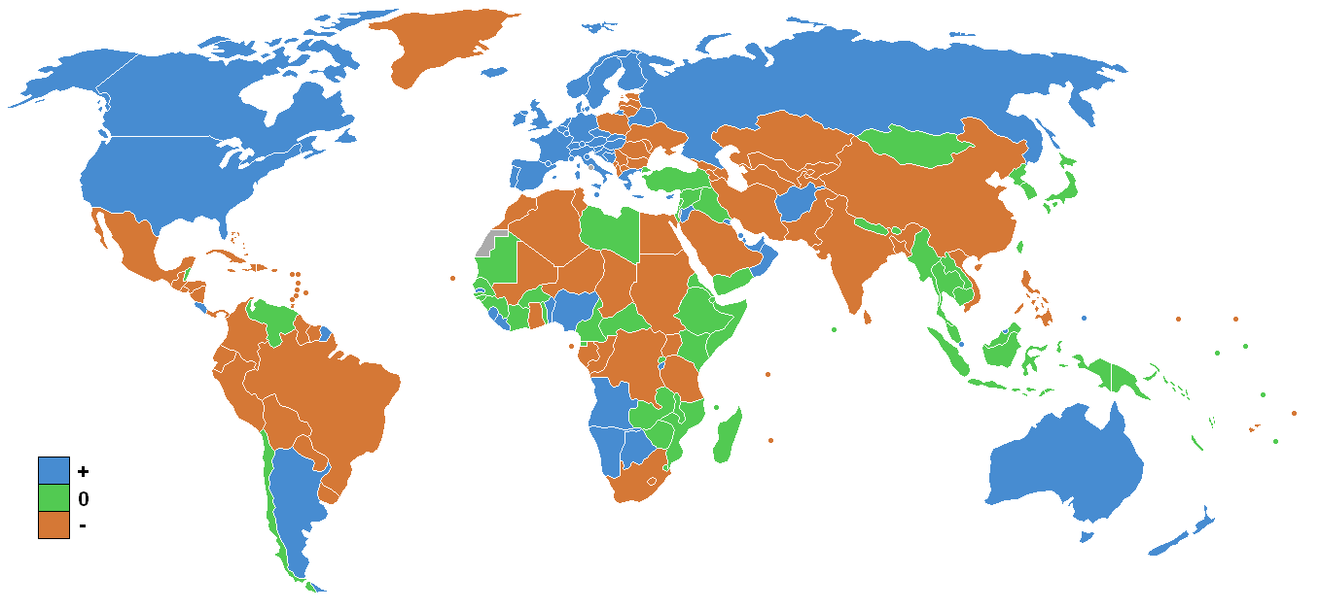
Where do migrants come from?

Slide 6
Push factors: reasons why people leave (war, famine, work)
Pull factors: reasons that attract people to a country (job opportunities, freedom from danger, better climate
Barriers to migration: anything that can make it difficult (immigration laws, cost of fare etc.)

Slide 7
TYPES OF MIGRATION
Forced migration: non-voluntary movement to escape an armed conflict, violence, violation of rights or man-made disaster (kidnapping of children to become soldiers/slaves in Angola, escape famine in Darfur Sudan, religious intolerance in Afghanistan)
Voluntary migration: own choice to move (job offer, education opportunities)
Internal migration: within a country (person in Cork gets a job in Dublin)
International migration: between countries (Ireland to Australia)

Slide 8
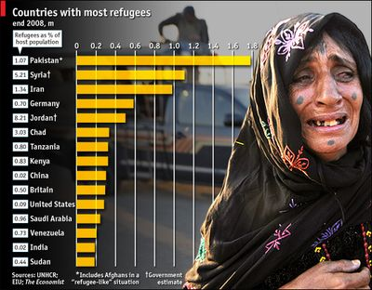

Slide 9
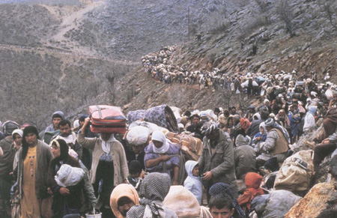

Slide 10
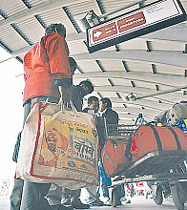
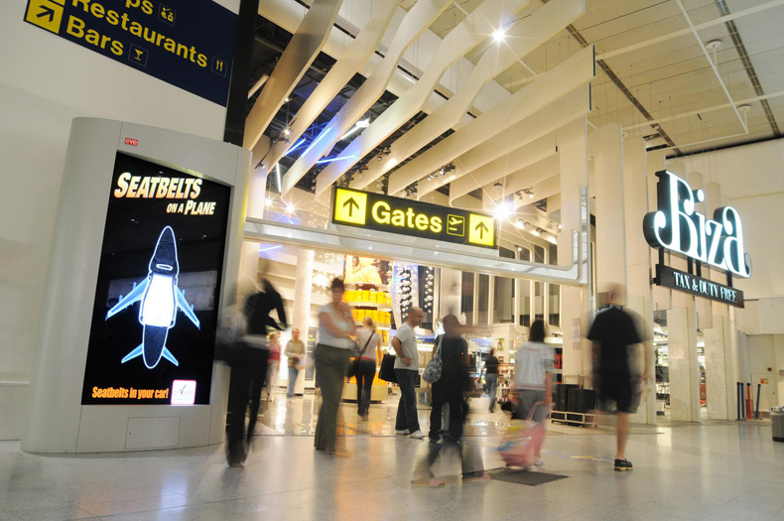

Slide 12
ADVANTAGES OF MIGRATION FOR THE HOST COUNTRY (receiver country)
Economy may depend on migrant workers
Migrants may be needed to fill vacant jobs
Jobs shortages in retail, hotel and catering, financial services, IT, engineering, health and food industry
Migration allows these industries to find skilled workers

Slide 13
ADVANTAGES OF MIGRATION FOR THE HOST COUNTRY (receiver country)
In 2006, 50% of jobs in the food production were filled by migrant workers (over 1000 Brazilian workers live in Co Galway
In 2005, Ireland needed 45,000 immigrants for the workforce so immigration was necessary
Migrants contribute to host country as they needs goods and services and their taxes contribute to government funds (Polish newspapers and food shops)
Greater awareness of different races and cultures as migrants settle into society

Slide 14
ADVANTAGES OF MIGRATION FOR THE DONOR COUNTRY (source country)
Money sent home is an important source of outside funding for developing countries. These remittance flows are the 2nd largest source of outside funding for developing countries after foreign investment by private companies (€176 billion sent home with €152 billion going to developing countries – World Bank 2005)
Migrants may learn important skills when they work and live abroad. If they return home, these skills can be used to benefit their own economy (nursing, medicine, education)

Slide 15
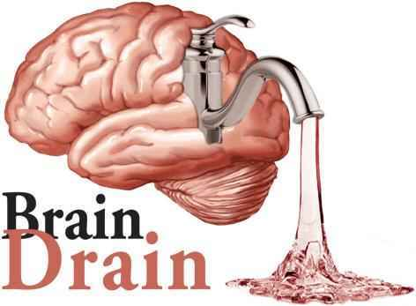
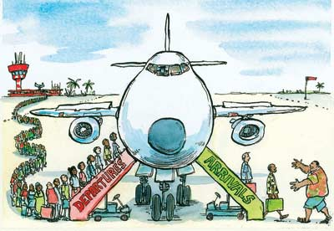
DISADVANTAGES OF MIGRATION FOR THE DONOR (country left)
People with technical skills, higher education and business ideas are most likely to leave.
This prevents full economic development of donor areas and improves the economy of the receiving area.
Many African countries are experiencing this brain drain.

Slide 16
DISADVANTAGES OF MIGRATION FOR THE DONOR (country left)
Ireland experienced this during the 1980’s (engineering, construction, nursing and teaching)
Investment in the education of its people is lost when they leave a country when emigration reached its peak
Potential tax contributions and spending power on goods and services is lost also

Slide 17
DISADVANTAGES OF MIGRATION FOR THE HOST COUNTRY (destination country)
When migrants first arrive, they need to find jobs and housing. This can lead to higher unemployment rates and puts pressure on health, education and transport facilities
Many migrants take lower paid and unskilled work and do not compete with Irish nationals for jobs
They may not have the language skills needed to improve job prospects which in some cases has led to discrimination and exploitation of the foreign workers

Slide 18
DISADVANTAGES OF MIGRATION FOR THE HOST COUNTRY (destination country
Integration of migrants into the community may lead to problems of racism and discrimination
Sometimes the reality of living in a new country does not match the expectations of migrants as they find themselves in low paid, unskilled work and often living in poor conditions

Slide 19
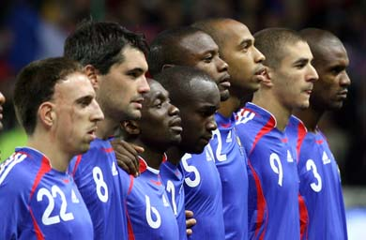
Racial Tensions: France
October / November 2005: Clichy Sous Bois eastern Paris
Two youths chased by police, ran into Power Station and electrocuted
Sparked off riots, vandalism and looting in Paris and many cities around France
Why?
Pre existing tension between the migrants from North Africa
About?
Their care or lack of since arriving in France. Their sub standard accommodation, access to jobs, standard of living etc.
Riots spread to 274 towns
€200 million of damage caused
2,888 arrests and 1 death

Slide 20
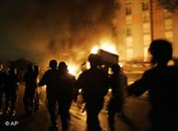
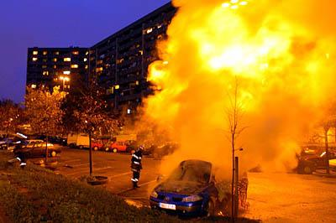

Slide 21
Solutions?
Government admitted that the rioting was due to their failure to provide opportunities for thousands of North African immigrants.
€30 billion was provided to help young people in riot zones
239 ‘Hot Zones’ created where the focus was on providing employment for 1.5 million.
……but…….
There is still evidence of racism towards Arab sounding names…..

Slide 22
Ethnic, Racial and Religious Issues arising from Migration

Slide 23
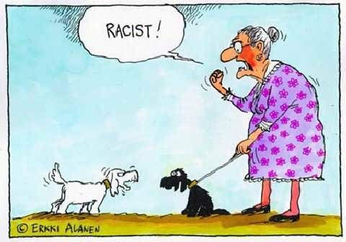

Slide 24
Racism
RACE is the grouping of humans based on their physical appearance.
ETHNIC GROUP is a group of people who share the same nationality, race or clear cultural similarities.

Slide 25
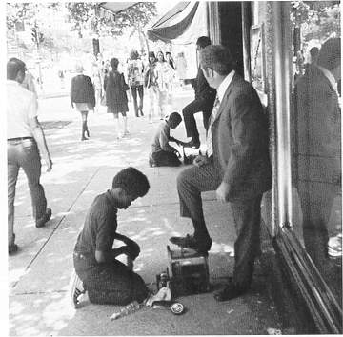
Racism………the belief that any other group of people is inferior because of their skin colour or ethnic group

Slide 26
Racism in Ireland
?
Tackling
As the number of foreign nationals increase in Ireland so does the level of racism.
Assaults on foreign nationals has increased ………
35% of immigrants experienced harrassment in public places……

Slide 27
Who experiences racism in Ireland?

Slide 28
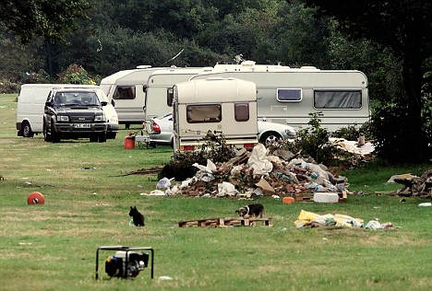
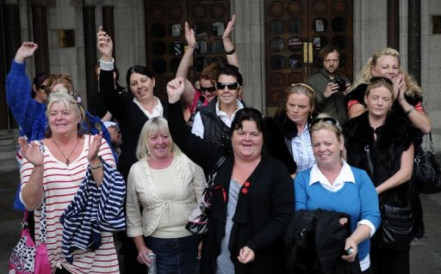
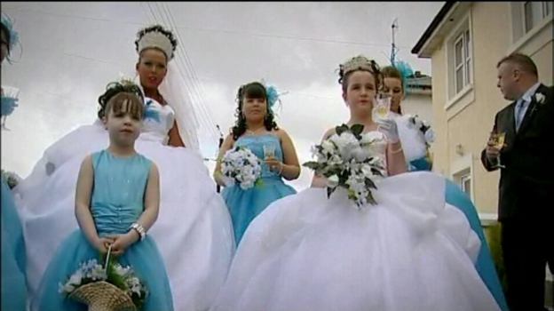
1
Travellers

Slide 29
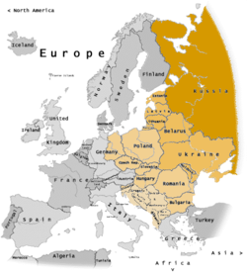
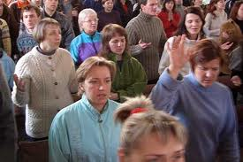
Eastern Europeans

Slide 30
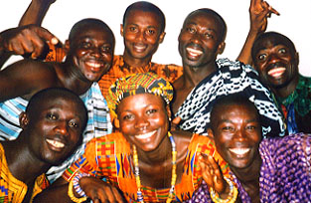
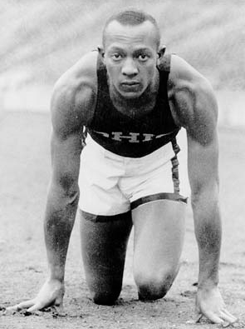
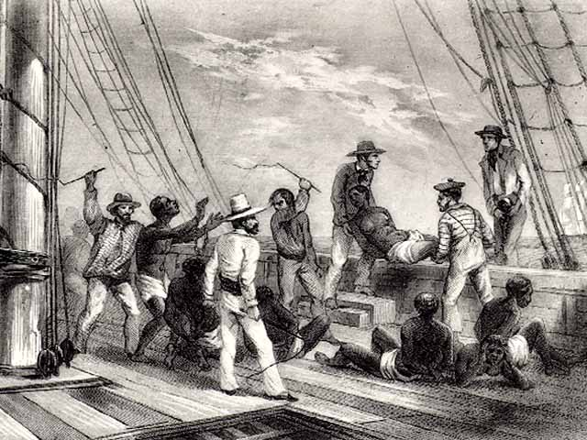
Africans

Slide 31
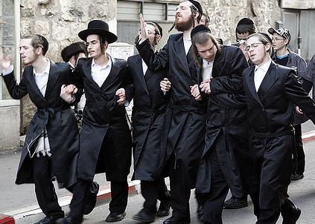
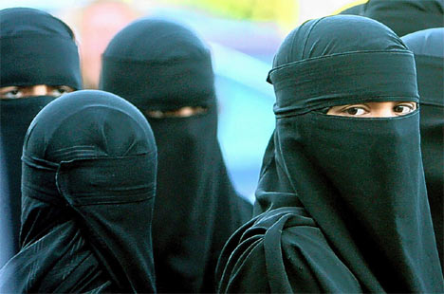
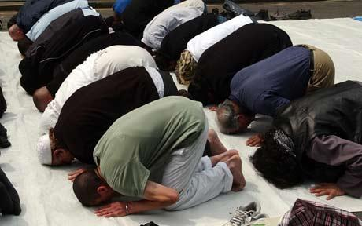
Jews & Muslims

Slide 32
National Policy against Racism
Everybody – regardless of nationality – should have the right to:
Participate in all areas of life (political, policy and community)
Be recognised for who they are in all aspects of life and all medias
Be provided for in government services throughout all departments
Be included in all areas of socio and economic life
Be protected by the same laws as everyone else.

Slide 33
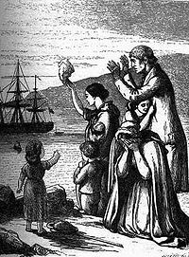
Ireland and migration

Slide 34
1996
It is said that Ireland has the most liberal migration laws in Europe and beyond. All EU member states are entitled to the same laws, housing, welfare and labour as Irish citizens.
But we also have liberal laws for those who wish to live and work here from beyond the EU…..
Once they have being ‘recognised’ by the Irish government they can apply for all the benefits we currently do.
Ireland was the last country in the EU to show figures of NET Immigration…this means there were more people coming into the country than leaving it.
Why?
Rapid Economic Growth: The Celtic Tiger

Slide 35
Patterns of Migration

Slide 36
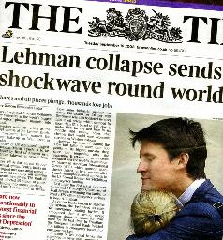
1840 – 1950s: Emigration
USA, UK
1960s: World boom (strong economy)
Rise in living standards and employment encouraged people to stay in Ireland
1970s: Immigration
Joined the EEC in 1973 (now EU) and many returned home. Higher immigration than emigration
1980s: Emigration
Recession, depression and brain drain
1980+………..
Celtic Tiger…massive growth, population birth rate explosion…net immigration……
And then………
2008….Collapse of Lehman Brothers financial group (USA)….world uncertainty………..recession……….collapse of building industry…………….
…………….now……………..

Slide 37
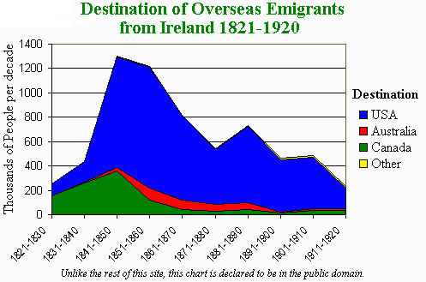

Slide 38
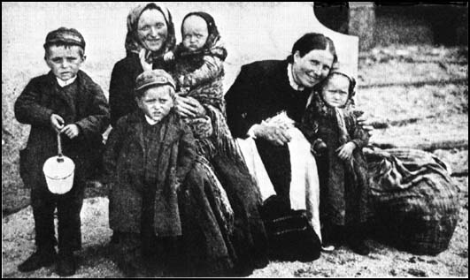

Slide 39
Migration policy in Ireland and the EU
What are the four categories of permit for those applying for work from outside the EEA? (European Economic Area)
The Four categories of permit for those applying for work from outside the EEA are:
The Green Card Scheme
The Work Permit
Intra-Company Transfer permit
Spousal and dependent permits
List three rights of migrants workers in Ireland.
Three rights of migrant workers in Ireland are:
They have the same employment rights and protection as Irish workers
They are entitled to the minimum wage
They are entitled to change employer after 12 months

Slide 40
What is a refugee? What is an asylum seeker….is there a difference?
A refugee fleas their country in fear of persecution on the basis of race, religion or personal beliefs. Their human rights may be compromised.
An asylum seeker is a person who (is a refugee) applys for assistance from the country they land in and hopes to get refugee status. If this is approved they have the same entitlements as all other citizens.
A refugee and asylum seeker are legally different. Once a refugee applies for help they are called an asylum seeker…..however…if the application is approved they are granted ‘refugee status’ and have legal rights in the new country.
Why is a migration policy needed?
A migration policy is needed to create a common basis of agreement between different countries who have different rules. This policy might reduce illegal trafficking in some countries.
Briefly list four benefits of a common migration policy?
Four benefits of a common migration policy include:
Reduction in illegal trafficking
Assist countries such as Spain and Italy facing high numbers of migration
A quicker process of applying for asylum
Easier for migrants to get work permits and residency.

Slide 41
Briefly list three problems associated with a common migration policy?
Three problems with a migration policy include:
Europe could be regarded as a fortress and impossible to enter
A clear dividing attitude between residents and migrants (us and them attitude)
Real migrants might face impossible difficulties when trying to move.

Slide 43
Migration

